Slide 1

Innovative Pedagogy
&
Lifelong Learning

Slide 2
We need technology in every classroom and in every student and teacher’s hand, because it is the pen and paper of our time, and it is the lens through which we experience much of our world.
- David Warlick

Slide 3
Definition Pedagogy
The word "PEDAGOGY" is derived from the Greek words “PAIDOS” meaning a "boy or child," and “AGOGOS” meaning a "leader“.
A PAIDAGOGOS was a slave who accompanied boys to and from school, tutored them after school, and taught them manners.
The word "PEDAGOGUE" eventually came to mean "TEACHER," and because it still has an outdated ring to it, people sometimes associate it with stuffy, dull instructors.
Pedagogy refers to the education, the profession and science of teaching, for example as a college subject and pedagogic training is what everyone majoring in education receives.

Slide 4
Different Components of Pedagogy
the content of what is being taught
Learning
CURRICULUM
TECHNIQUES
METHODOLOGY
way in which teaching is done
for socializing children and affective skills required for successful functioning in society

Slide 5
History of Pedagogy
In order to trace the history of pedagogy, it’s important to first define the concept of “pedagogy” itself, whose meaning has undergone numerous iterations over the centuries. The concept has always been associated with the history of the development of thought, instructional institutions, and the advancement of knowledge, on which thinkers – educators – have always relied.
Pedagogy is an art - Right from the beginning, education was assigned the status of art – the art of teaching, of leading children to knowledge. This concept reminds us that the profession of an educator first emerged in Ancient Greece. Back then, the role of the educator was performed by slaves, who were given the noble task of walking the master’s children to school, taking care of their physical appearance, and accompanying them during their chores and play. The founding father of education is widely considered to be Socrates (5th century BC).
Pedagogy is a science - At the end of the 19th century, the development of such scientific fields as sociology and psychology is accompanied by the emergence of pedagogy as applied science,” that is, it starts to be viewed as a true science. Pedagogy is now treated as a science with the understanding that its ultimate objective, as in the other cases, is not so much to describe or explain but instead to guide the process of teaching and learning.
Pedagogy is an applied science - Today, we no longer debate whether pedagogy is an art or a science. We live at a time when pedagogy – just as medicine or politics – is viewed as an “applied science,” that is, as a discipline geared towards the practical application of acquired knowledge.

Slide 6
Traditional Approach
Ancient Approach
Medieval Approach
Modern
Approach

Slide 7
Traditional Approach – Ancient
Our ancient educational system, which dates to the Rigveda, developed over time and was focused on the holistic development of the person. The framework emphasizes the moral, practical, intellectual, and spiritual facets of life.
The ancient system of education was the education of the Vedas, Brahmanas, Upanishads and Dharmasutras. The writings of Aryabhata, Panini, Katyayana and Patanjali and the medical treatises of Charaka and Sushruta were also some of the sources of learning.
Distinction was also drawn between Shastras (learned disciplines) and Kavyas (imaginative and creative literature).
Students took part in krida (games, recreational activities), vyayamaprakara (exercises), dhanurvidya (archery) for learning martial arts, and yogasadhana (training the mind and body), among other physical education activities. Younger students were mentored by students who had higher learning skills.
Ancient India had both a formal and an informal educational system. Home, temples, pathshalas, tols, chatuspadis, and gurukuls were all places where indigenous education was given.For higher education, students travelled to universities and viharas. Because most instruction was given orally, the material was retained and discussed by the students.

Slide 8
Traditional Approach –Medieval
Numerous Mohammadians invaded India in the ninth century AD. Mahmud Ghaznavi conquered India and used the seized money to establish numerous schools and libraries throughout the nation.
Muslim rulers later built a lasting empire in India and introduced a new educational system.
The old educational system underwent a significant transformation. The most notable alteration was the Islamic form of education, which was distinct from the Buddhist and Brahminic education system.
The Arabs and Turks brought new cultures, traditions, and institutions to India. The Islamic and Mughal systems were heavily emphasized in the educational system of the mediaeval era.
The dissemination of knowledge and the spread of Islam were the primary goals of education during the Middle Ages.
The methods of learning includes reading, discussions, recitations, writing and to reform the scripts/lessons. words-knowledge, and then sentence formation. Students were evaluated based on practical situations of life

Slide 9
Traditional Approach – Modern
Over the course of the British Empire, modern education was established. English was first spoken in the 1830s according to Lord Thomas Babington Macaulay. The primary goal of British modern education, despite its rather constrained subjects and curriculum, was to promote English and also to disseminate Christianity to a certain extend. As time went on, education began to advance and reached the modern period, or the twenty-first century, which is the era of science, technology, and advancements. Furthermore, just as in the ancient and mediaeval eras, there is still a need for education. Today's contemporary period of science and technology is characterized by a steadily growing industrial sector.
Methods of learning
Students also adapted to learn concepts through online platforms like YouTube, Coursera, Udemy etc.
Students refer to the notes given by the teacher’s side by side while learning online.
During class hours doubts are solved through discussions, debates, etc.
Student assessment was done based on their mid-semester written examspractical exams etc to check their knowledge and skills.

Slide 10
Innovative Pedagogy
Crossover Learning
Learning Through Argumentation
Incidental Learning
Flipped Classroom
Context-Based Learning
Computational Thinking
Embodied Learning
Analytics Of Emotions
Gamification
SOLE SESSIONS
Learning By Doing Science
Stealth Assessment
Adaptive Teaching

Slide 11
Evolution of learning

Slide 12
Relationship between Curriculum, Pedagogy & Learning
The curriculum is the content you teach in traditional education, curriculum also standardizes the learning goals for an entire school and provides a clear path for students to progress from one grade to another
Pedagogy is how you teach it.
In education, pedagogy and curriculum blend as understanding how to teach and why you teach in a certain way.
curriculum
pedagogy
Learning

Slide 13
Few Examples of Innovation Pedagogy tools list
Prezi
Haiku Deck
Scratch
Animoto
Pixton
BoomWriter
Explain Everything
Educreations
Piktochart
Visme
StoryJumper
VoiceThread
Storybird
Quizlet
Padlet
Flipsnack
Edmodo
Schoology
Glogster
Socrative

Slide 14
Advantages of Technology in Education
Technology helps students to stay motivated during the learning process.
It encourages more communication between teachers and parents .
It creates new ways to learn for today’s student .
Technology allows us to give students access to data from a single location.
Technology in the classroom encourages collaboration.
It encourages students to stay engaged with their learning environment.

Slide 15
Disadvantages of Technology in Education
The presence of technology can be distracting to students.
Technology can make it easier to cheat.
Using tech can cause some students to disconnect from the classroom.
Technology is a resource that not all families can afford.
Some technologies could replace the teacher in some classrooms.
Students often lose track of time when using technology in the classroom.

Slide 16
Development of the modern pedagogy foundations
The structure of the pedagogical principles consists of a set of
paradigms (knowledge, cultural, humanistic, managerial, communication and social, societal, anthropocentric, technological);
an object (a person of any age);
a subject (a pedagogical system as a condition for the pedagogical process realization);
common principles (objectivity, clarity, historicity and consistency, subjects’ activity in understanding and transforming objects, practice relations, determinism, isomorphism, the ascent from the abstract to the concrete, systemic);
approaches (systemic, culturological, humanistic, cybernetic, social and communication, technological);
specific principles (interval, optimal, optimization, adaptation) and methods (simulation of pedagogical objects, statistical methods);
pedagogical technology (a set of pedagogical process steps and corresponding facilities).
Paradigms carry out the information function through the connection with factors (objective, subjective, personal, and human); instrumental function - through the connection with approaches; technological function – through the connection with principles and rules.
Pedagogical foundations give an opportunity to develop components of the methodological system that include philosophical and specific principles as well as characteristics of the educational system
The adaption in pedagogics is considered a three-dimensional object (levels: empirical, theoretical, technological)

Slide 17
Examples of India/World with respect to Innovative Pedagogy
Project-Based Learning (PBL)
Blended Learning – Blending learning combines online learning with traditional classroom learning.
EdTech – Educational technology (edtech) typically refers to any software, application or service developed to enhance education.
Feedback assessment tools
Video conferencing and virtual classrooms
Video projects
Real-time polling
Quizzing
Interactive whiteboards and file annotations
Video in the classroom

Slide 18
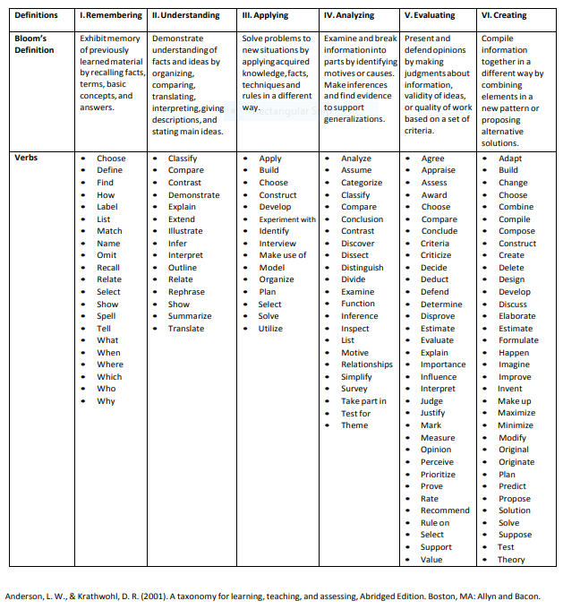

Slide 19
How does Effective Pedagogy lead to
LIFELONG LEARNING??
Definition: Lifelong learning encompasses the full range of normal, non formal and informal learning activity from pre-school to post retirement.
Why LLE is Essential??
Reconstruction of New Set of Values
Problems solving and Increase longevity of Human race
Promotes Citizenship and Facilitates Democratic Participation

Slide 20
Role of Lifelong learning
Role of Lifelong Learning
Active and Creative explorer
Reflexive and Self-Actualizing Agent
Integrator in emotional and professional context

Slide 21
Strategies Of LLE
STRATEGIES
National Policy
Formal and Non formal education
Alliance and Financial Strategies
Research and Action Plan

Slide 22
Established Trends for Lifelong Learning
Home Schooling
Self directed Learning
On Job training
Adult Education
Continuing Education

Slide 23
References
https://lepole.education/en/pedagogical-culture/27-history-of-pedagogy.html?showall=1
https://open.library.okstate.edu/applicationsofeducationaltechnology/chapter/chapter-11/
https://lepole.education/en/pedagogical-culture/27-history-of-pedagogy.html?showall=1
Lavryk TV, Yaresko EV. The Development of the Foundations of Modern Pedagogy: Paradigmal and Methodological Aspects of Research. European Journal of Contemporary Education. 2015;12(2):150-7.
https://www.edsys.in/best-pedagogical-strategies/
https://www.brookings.edu/blog/education-plus-development/2019/01/23/approaches-to-pedagogical-innovation-and-why-they-matter/
https://www.merriam-webster.com/dictionary/pedagogy
https://www.vocabulary.com/dictionary/pedagogy
https://nap.nationalacademies.org/read/9745/chapter/7
https://theeducationpost.in/historical-perspectives-in-indian-pedagogy/
https://ncert.nic.in/textbook/pdf/heih111.pdf
https://www.intechopen.com/chapters/73290
https://www.slideshare.net/maheshnangude/life-long-learning-25406167
https://graphicmama.com/blog/digital-tools-for-classroom/

Slide 24
Thank you

